Slide 1
Enhancing Fake Review Detection with Cross-Platform Analysis Using Supervised and Deep Learning Models and Feature Engineering Evaluation
Faryad Bigdeli

Slide 2
Literature Review

Slide 3
Gaps
Cross-Platform Adaptability
Effect of Feature Engineering
Comparison between Supervised and Deep Learning Approaches
User Feedback Integration

Slide 4
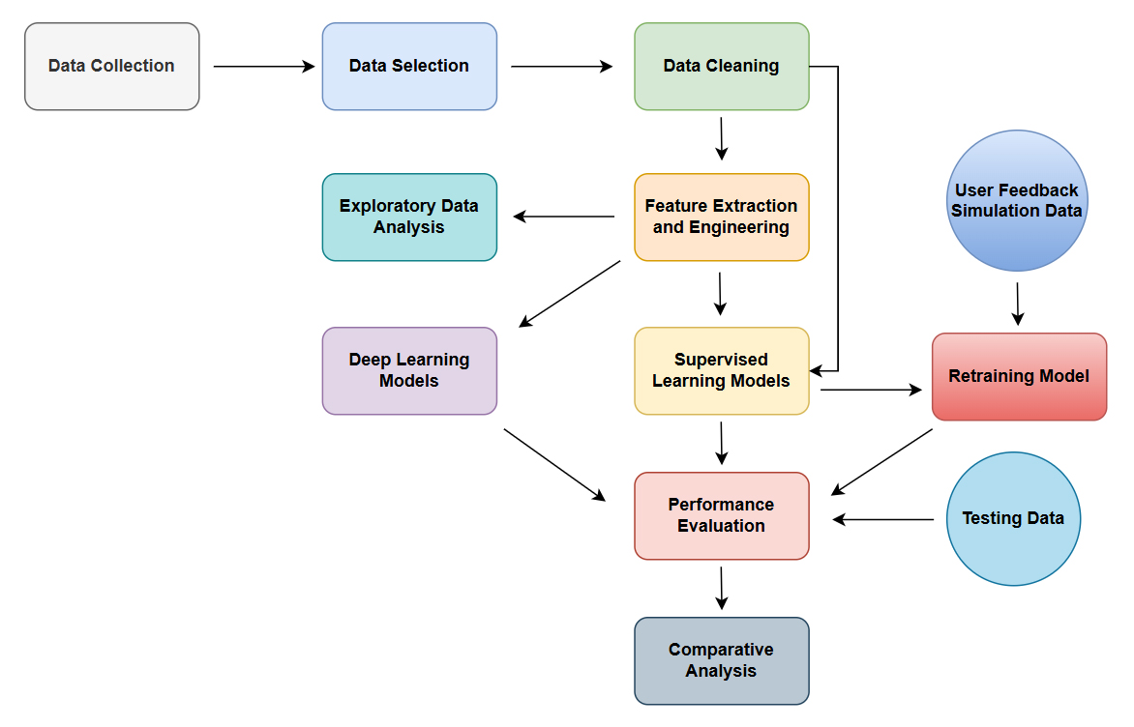

Slide 5
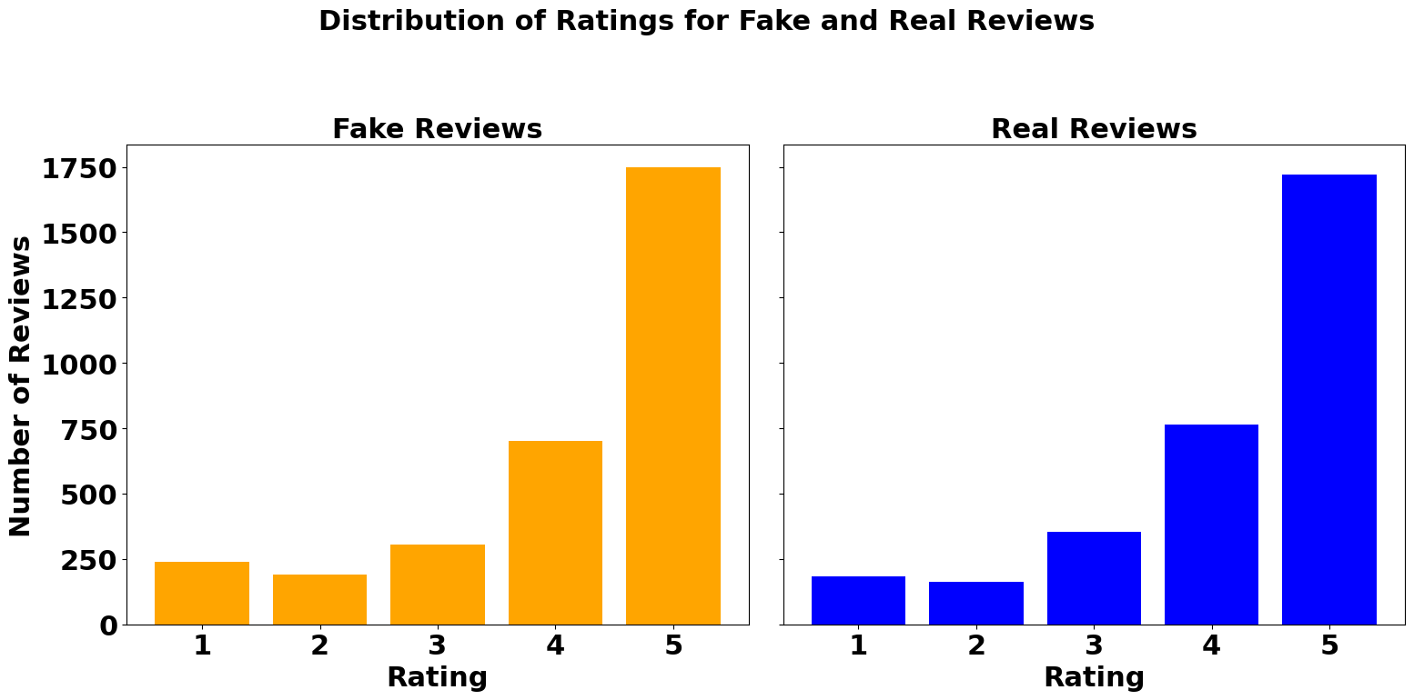
Exploratory Data Analysis (EDA)

Slide 6

Exploratory Data Analysis (EDA)

Slide 7
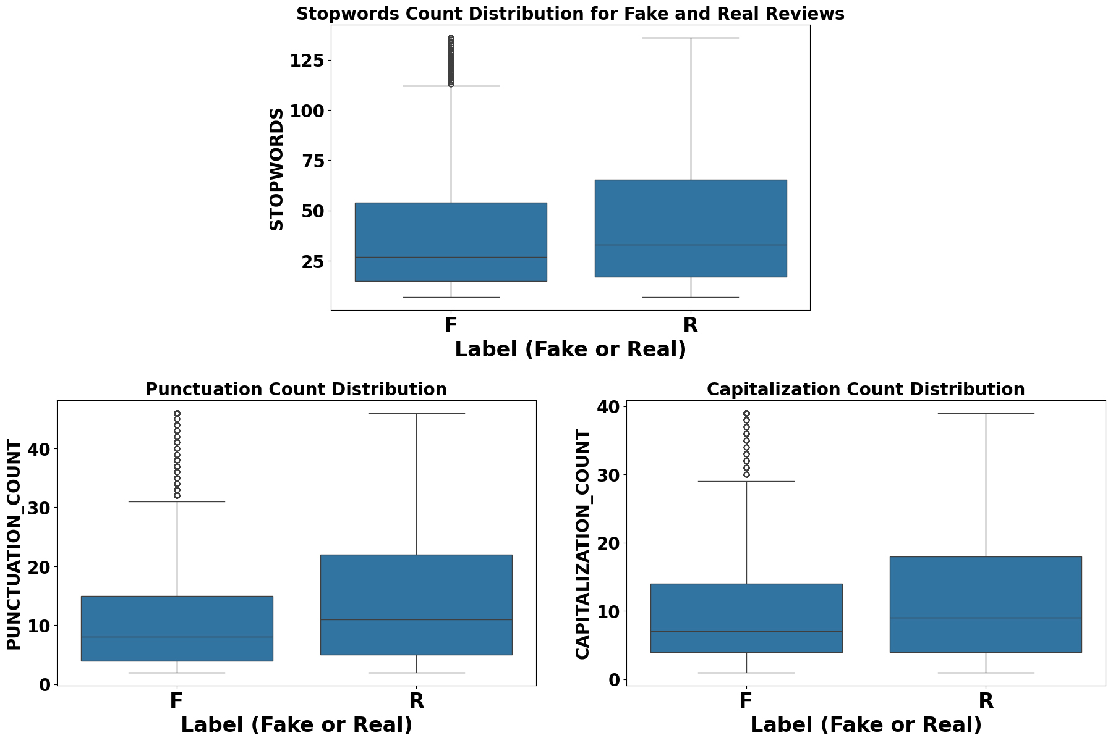
Exploratory Data Analysis (EDA)

Slide 8
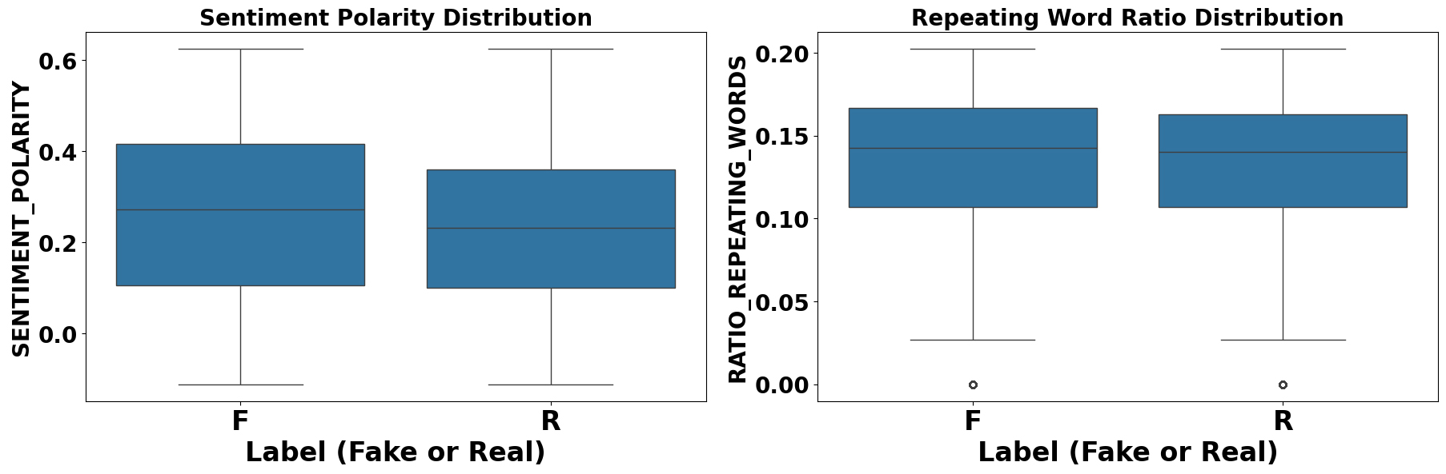
Exploratory Data Analysis (EDA)

Slide 9
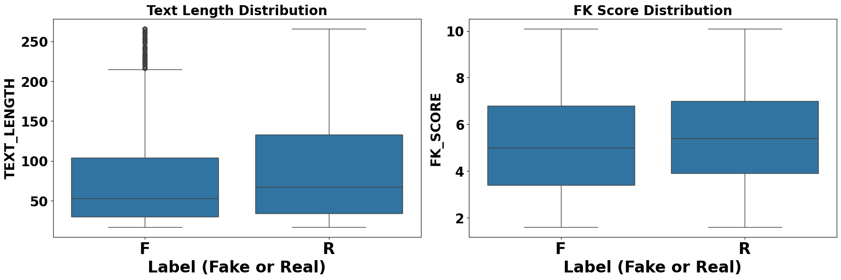
Exploratory Data Analysis (EDA)

Slide 10
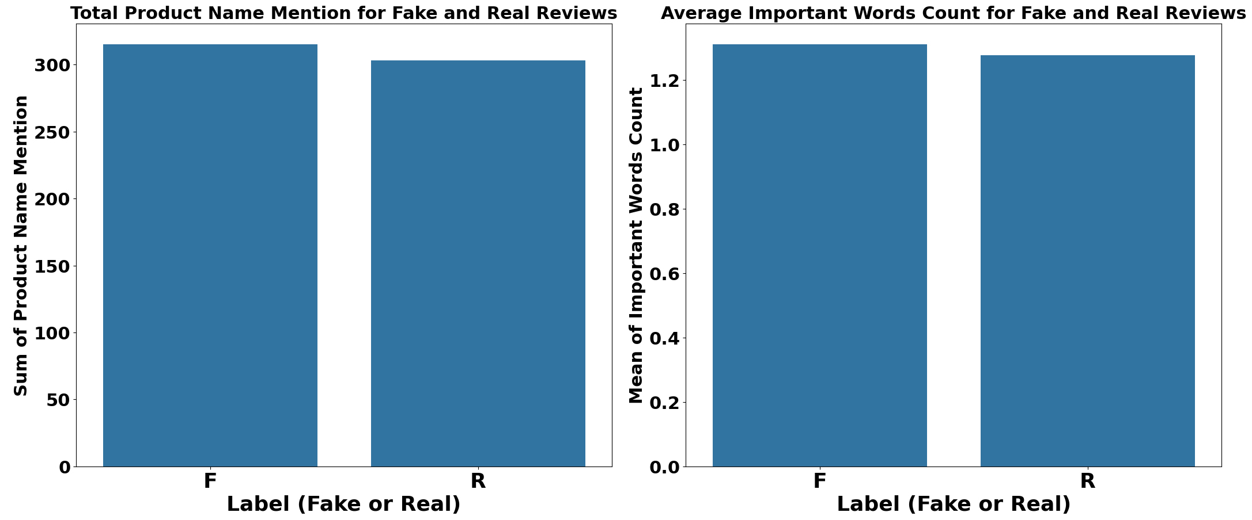
Exploratory Data Analysis (EDA)

Slide 11
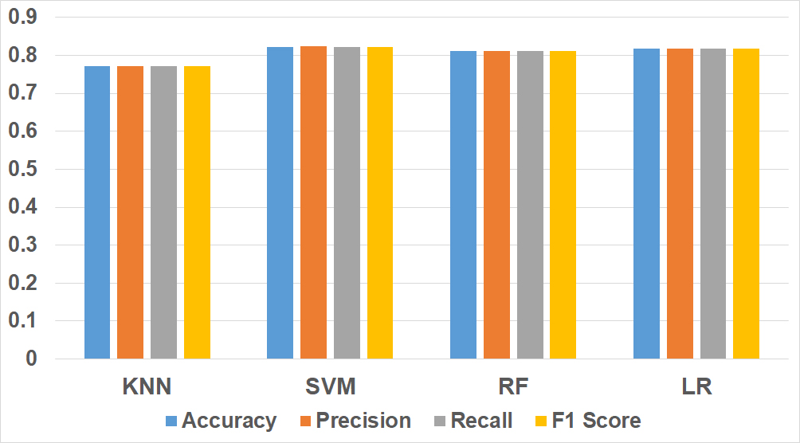
Supervised Learning Models

Slide 12
Supervised Learning Models

Slide 13
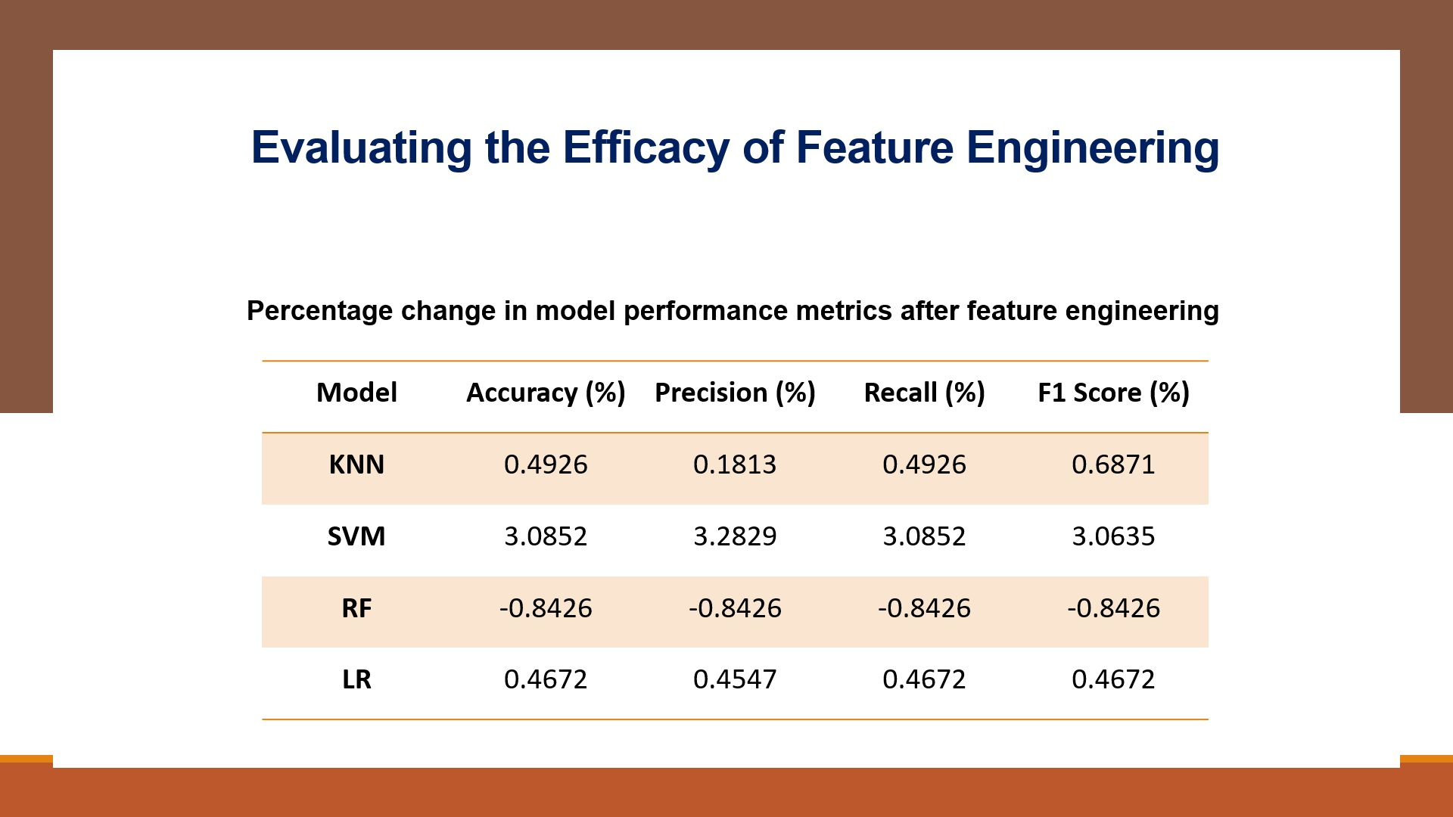
Evaluating the Efficacy of Feature Engineering
Percentage change in model performance metrics after feature engineering
Model | Accuracy (%) | Precision (%) | Recall (%) | F1 Score (%)
KNN | 0.4926 | 0.1813 | 0.4926 | 0.6871
SVM | 3.0852 | 3.2829 | 3.0852 | 3.0635
RF | -0.8426 | -0.8426 | -0.8426 | -0.8426
LR | 0.4672 | 0.4547 | 0.4672 | 0.4672

Slide 14
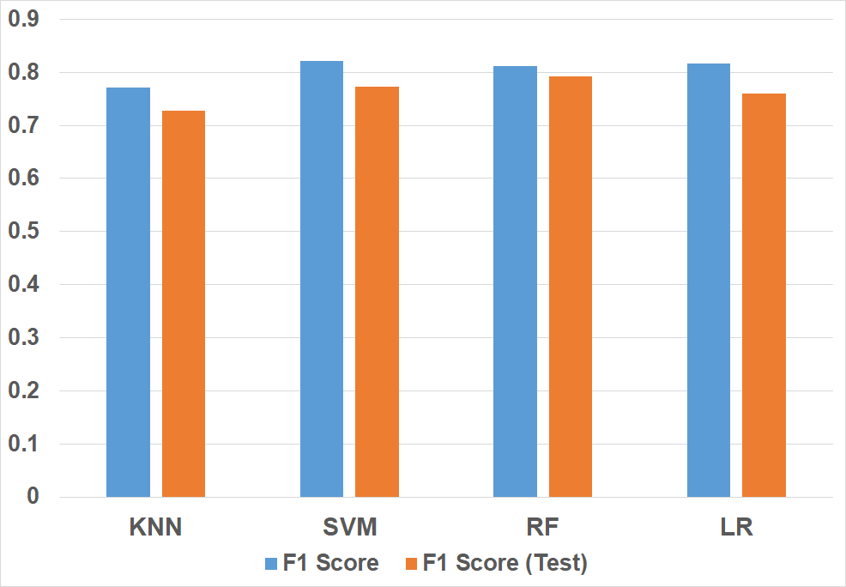
Testing Supervised Models with New Data

Slide 15
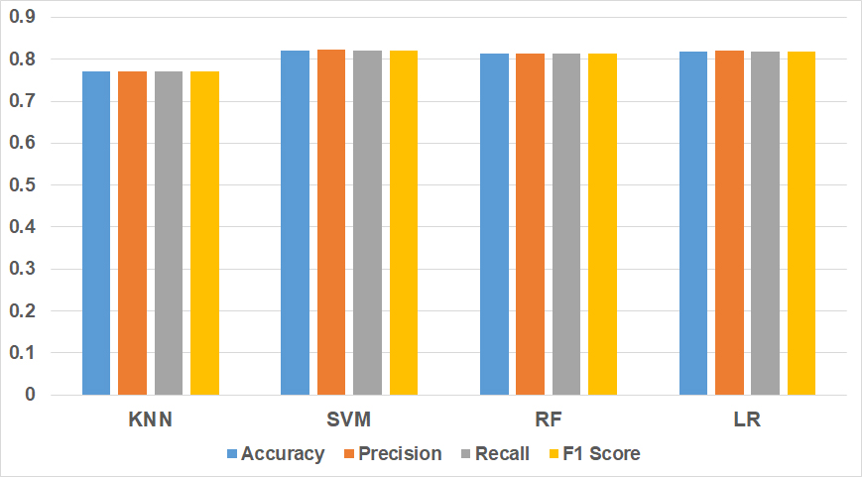
Simulating User Feedback

Slide 16
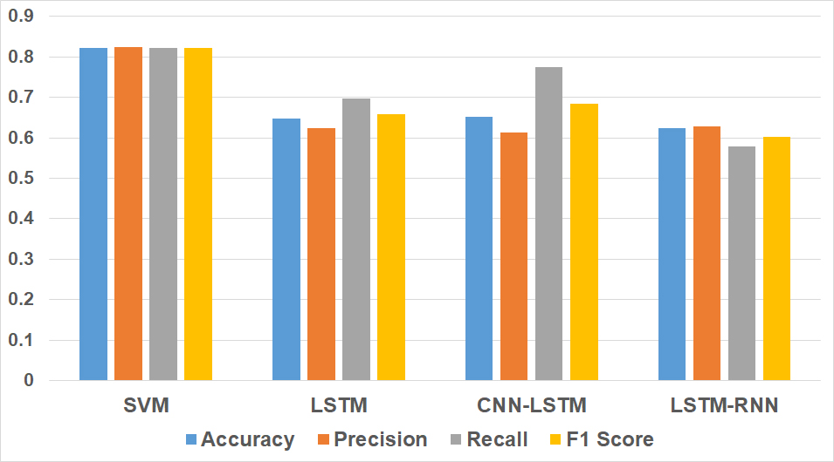
Supervised vs. Deep Learning Approaches

